Slide 1
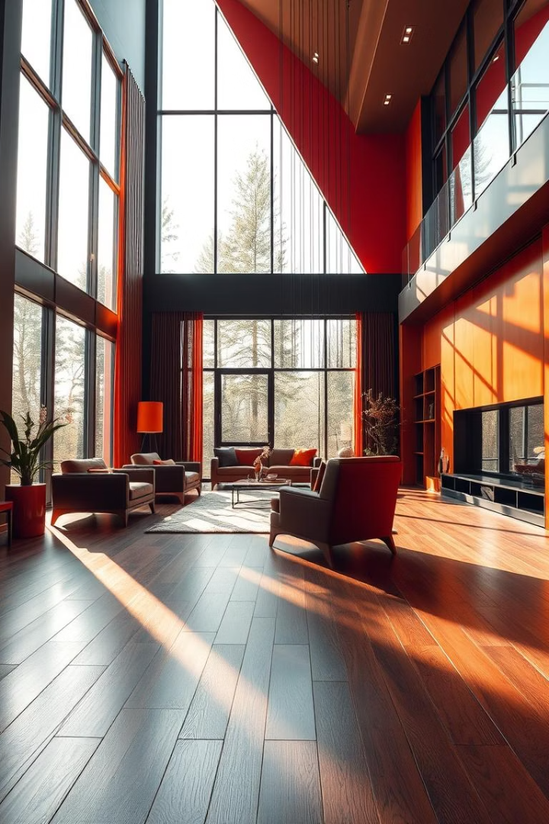

Introducing Our Exquisite Laminate Flooring
Discover the perfect blend of style and durability with our laminate flooring. Ideal for modern homes seeking beauty and practicality.

Slide 2
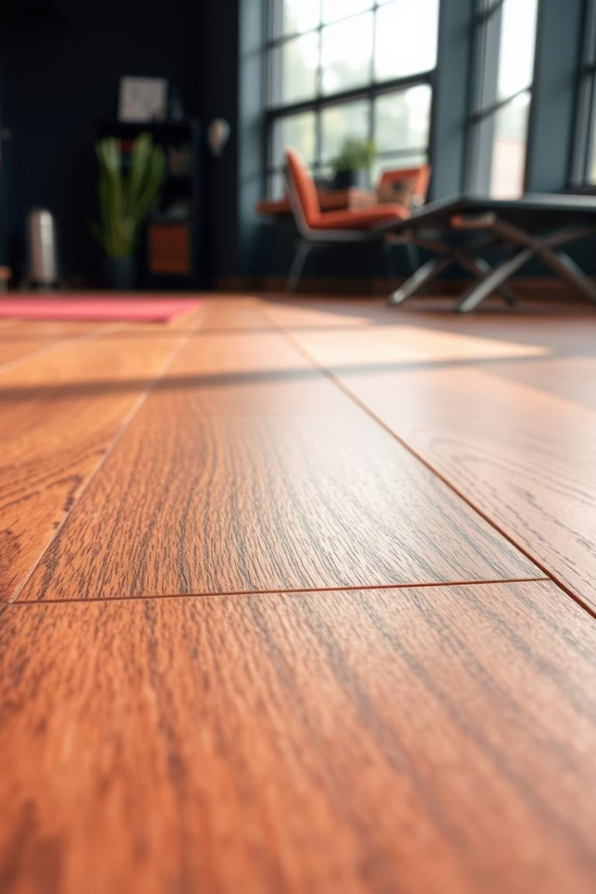
Why Choose Laminate? Durability and Affordability
Hardwearing Surface
Cost-Effective
Resistant to scratches, stains, and everyday wear
Offers an affordable alternative to natural wood floors
Low Maintenance
Easy cleaning without special treatments or waxing

Slide 3
Laminate vs. Hardwood: Making the Right Choice
Laminate Flooring
Hardwood Flooring
More affordable
Natural look and feel
Highly durable
Can be refinished multiple times
Variety of styles
Generally costlier

Slide 4
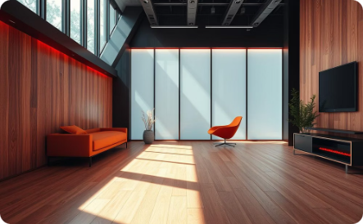
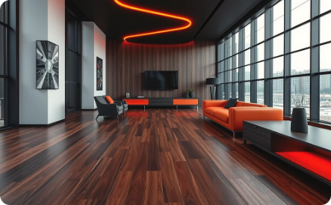
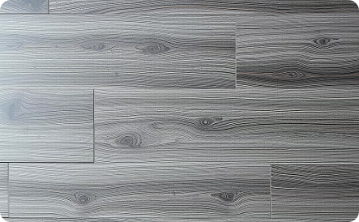
Our Range: Styles, Colours, and Finishes
Classic Oak
Timeless, bright and spacious feel
Rich Walnut
Luxurious and warm ambiance
Urban Grey
Modern, neutral and versatile

Slide 5
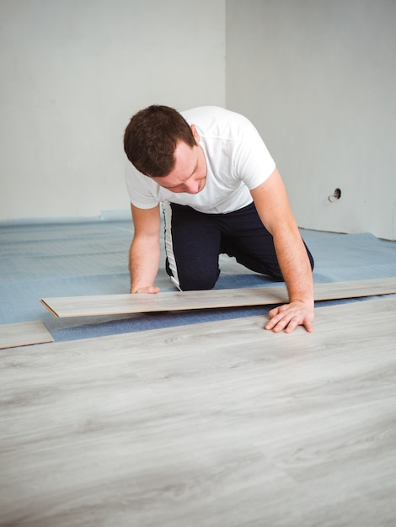




Installation: A Simple Step-by-Step Guide
Prepare the Subfloor
Clean and level the surface
Lay Underlay
Provides cushioning and moisture barrier
Click and Lock Planks
Snap boards together carefully
Finish Edges
Install trims and mouldings for a neat look

Slide 6
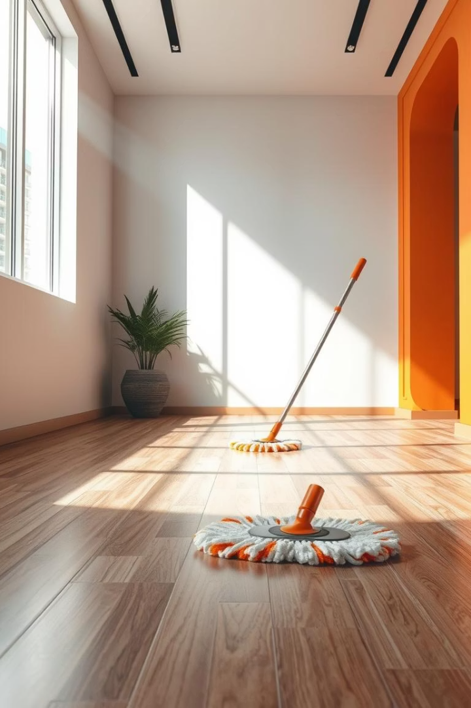
Maintenance: Keeping Your Laminate Looking Its Best
Regular Cleaning
Sweep or vacuum to remove dust and debris
Use Damp Mop
Clean gently with a damp mop, avoid soaking water
Protect Surfaces
Place pads under furniture to prevent scratches
Avoid Harsh Chemicals
Use laminate-specific cleaners for best results

Slide 7
Case Studies: Real Homes, Real Transformations
Home in London
Urban Flat Renovation
Transformed dated floors to sleek laminate for a fresh look
Chose light grey laminate to brighten compact space
Improved durability for high-traffic family area
Quick installation completed within 2 days

Slide 8

Sustainability: Our Commitment to the Environment
Responsible Sourcing
Low VOC Emissions
Recyclable Materials
Materials sourced from certified sustainable forests
Ensuring healthy indoor air quality
Laminate boards crafted to reduce waste impact

Slide 9
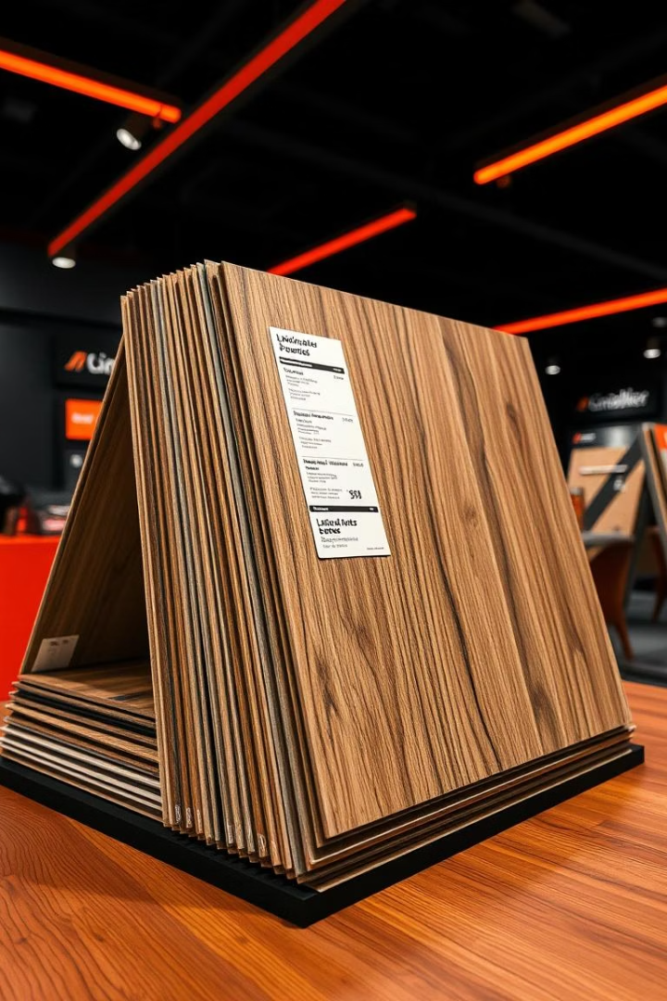
Pricing and Packages: Find the Perfect Fit for Your Budget
Package
Features
Price
Basic
Standard colours, DIY installation
£15 per sqm
Premium
Wide style options, professional install
£30 per sqm
Luxury
Exclusive finishes, extended warranty
£45 per sqm

Slide 10

Questions and Special Offers
Special Discounts
Consultation
Customer Support
Seasonal promotions and bundle offers available
Book a free appointment with our flooring experts
Dedicated team to assist you every step of the way

